Slide 1
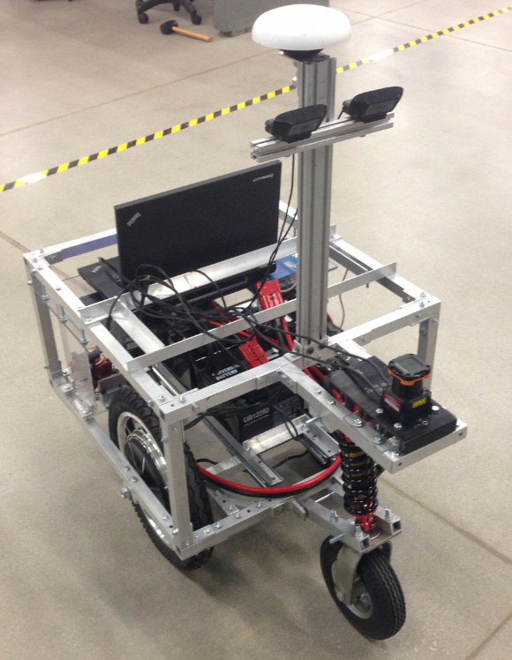
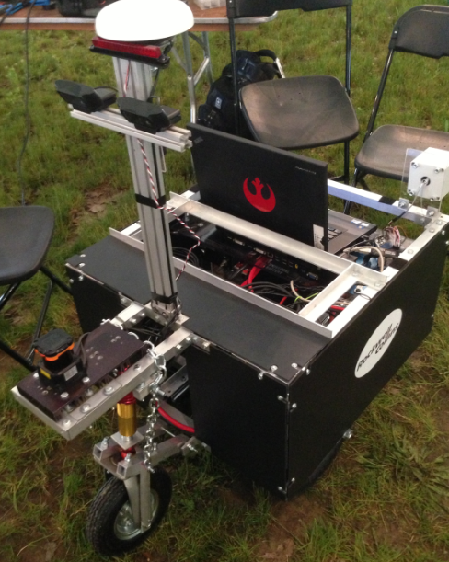
Rose-Hulman Institute of Technology
2013 IGVC Design Entry: GALATEA
Team Members:
Quamme Bradley, Sean Carter, Spencer Carver, Elena Chong, Allison Crump, Rain Dartt, Ben Griffith, Derek Heeger, Alex Memering, Michael Pauly, Gustavo Romo, Matthew Schack, Ander Solorzano, Andrew Tebbe, Elias White, Ruffin White, Kurtis Zimmerman
Team Advisors:
David Mutchler (Ph.D. Computer Science)
David Fisher (Ph.D. Mechanical Engineering)

Slide 2
Presentation Overview
Overall Design Plan
Hardware Features
Overall Software Design Concept
Software Features and Innovations
Concluding Remarks

Slide 3
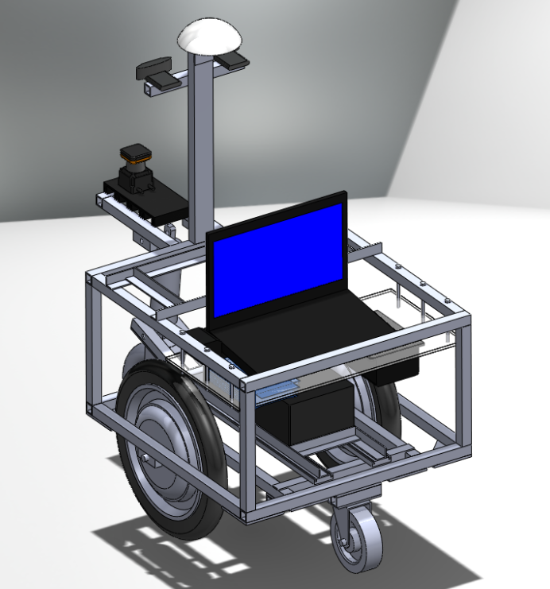
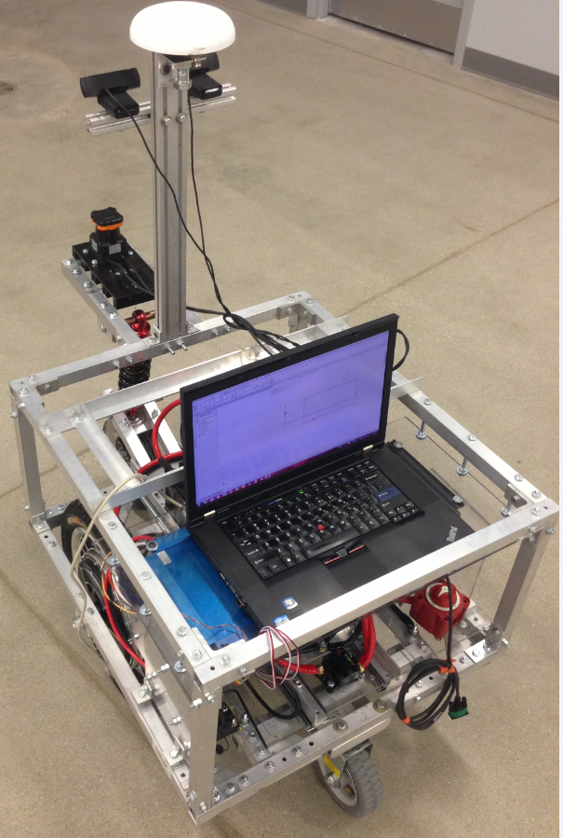
Overall Design Plan
Determine objectives and goals
Construct model and purchase parts
Construct frame and install sensors and computer
Durable and reliable
Lightweight and centralized lower weight
Intelligent
Maneuverable
Safe
Off-road locomotion
Create and test software algorithms
Observe and verify performance
Make changes and improvements if needed

Slide 4
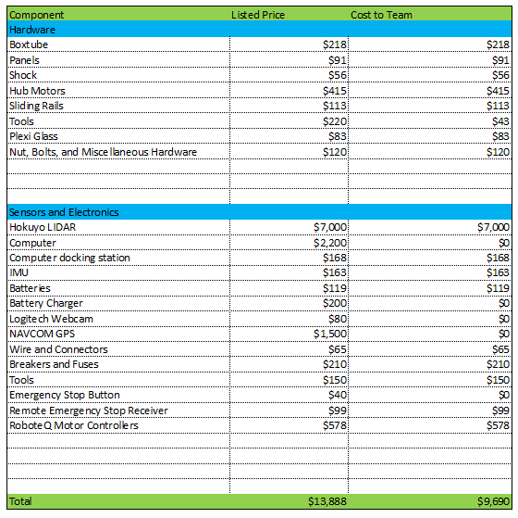
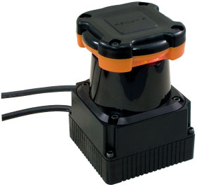
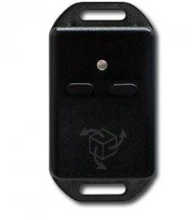
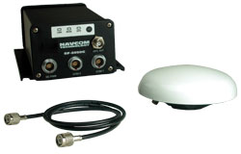
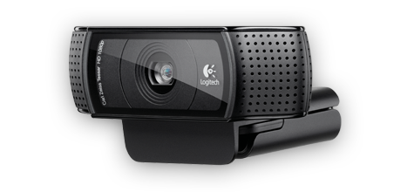
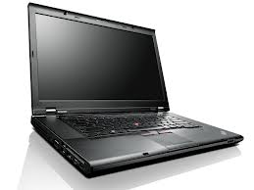
Major components and costs
HOKUYO LIDAR
YEI 3-Space IMU
NAVCOM GPS
Logitech Webcam
RoboteQ Motor Controller
Lenovo w530

Slide 5
Mechanical features
Results
Designed to be small and compact
Hub motors with built in hall-effect sensors
Shock to dampen bounces
Easy-to-remove panels for access to the robot
Low center of gravity adds stability
High turning speed
Small turning radius
Easy serviceability
Sensors susceptible to less noise

Slide 6
Main Electronics
Hokuyo LIDAR offers 30 m detection with a 270º sweep angle
HBL2350 dual channel 3-phase RoboteQ motor controller with deadman switch capabilities
On board 12V power distribution board with built-in protection and indicators
2 12V lead acid batteries connected in parallel and placed in a moveable rack
Stereoscopic Logitech webcam array
Incorporated the WAAS features of the NAVCOM GPS provides 10 cm accuracy
Results
Power distribution more reliable and safe
Large obstacle detection view
Long battery life
Fast and sufficient line detection
Improved waypoint navigation

Slide 7
Overall software design concept
Sense
Initialize all sensors and gather data from the environment
Think
Process all gathered data and determine best plan of action
Act
Use the motor to turn or head towards the goal through a safe and efficient path

Slide 8
Software implementation
Start sense loop
Start think loop
Start act loop
Stop sense loop
Handle events
and visualize inputs
Stop act loop
Stop think loop
Graphical
Intuitive building
Fast programming
Robotics friendly environment
Understandable by different engineers
Easy debugging

Slide 9
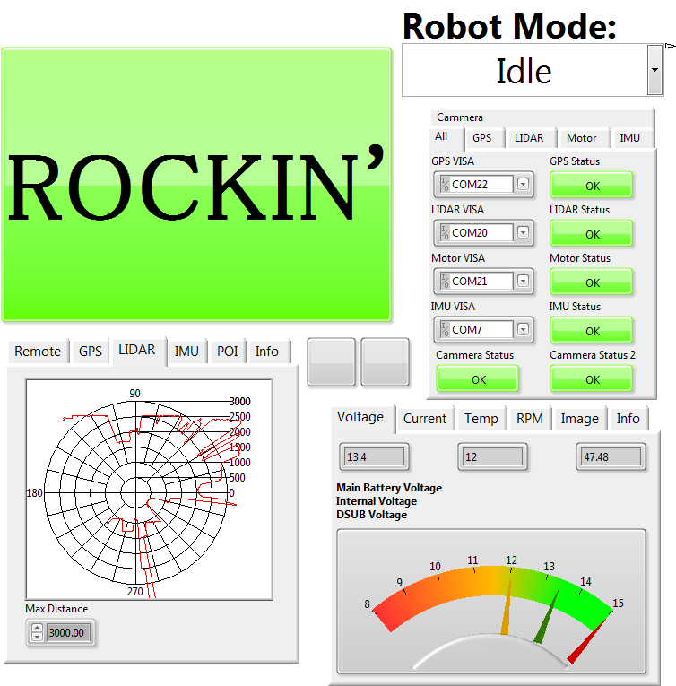
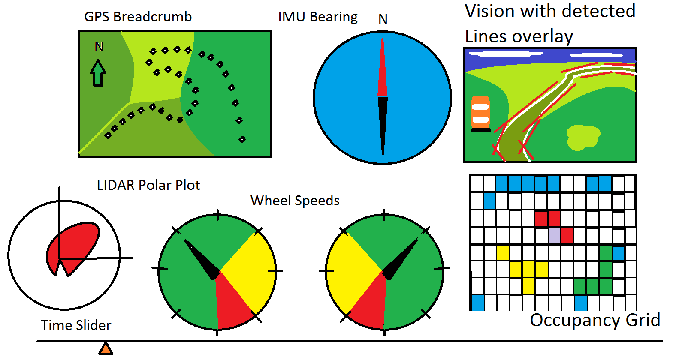
Over View

Slide 10
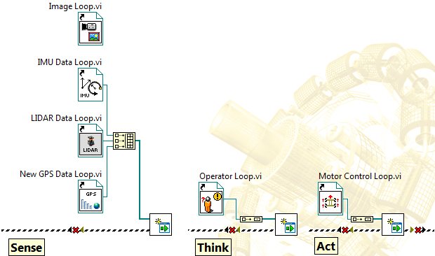
Framework
Sense
Think
Act

Slide 11
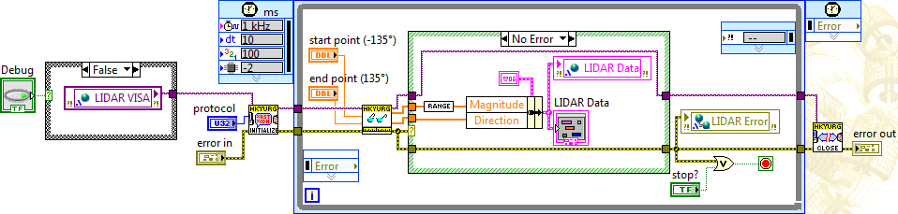
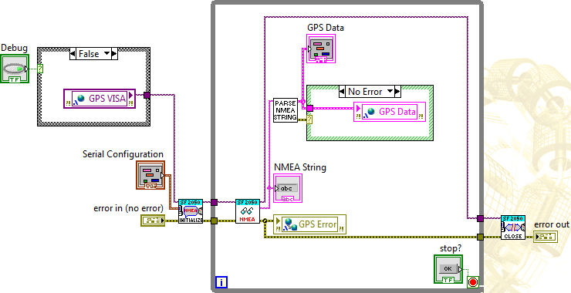
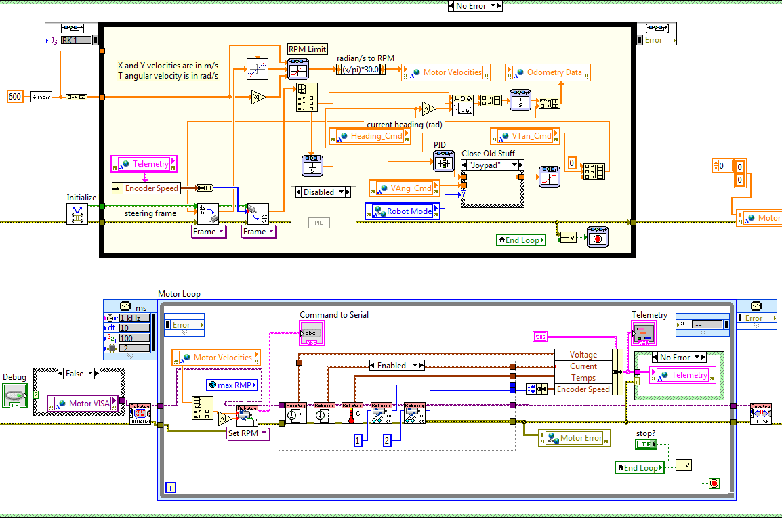
Sensor loops
Loops continuously update in parallel

Slide 12
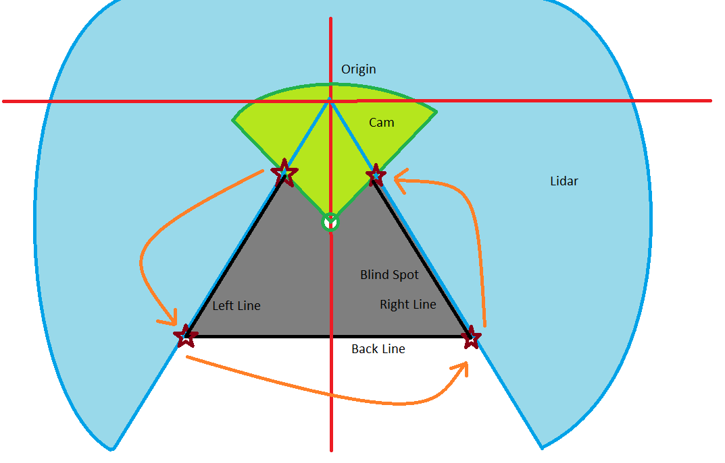
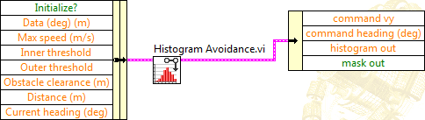
Obstacle detection

Slide 13
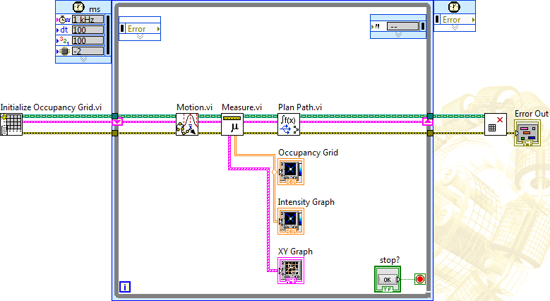
Occupancy grid
Sense
Think
Act

Slide 14
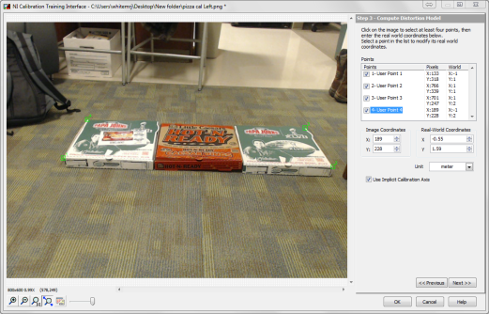
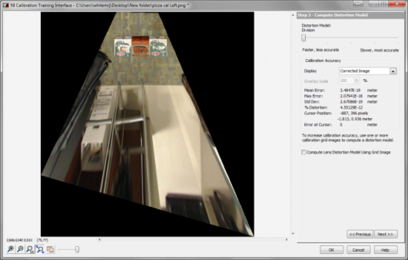
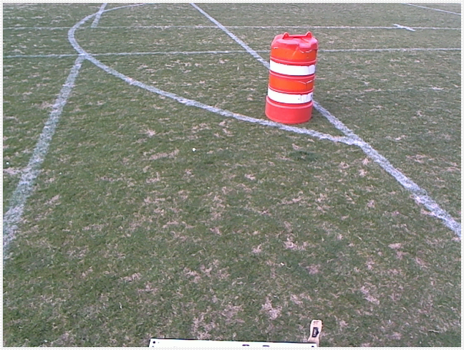
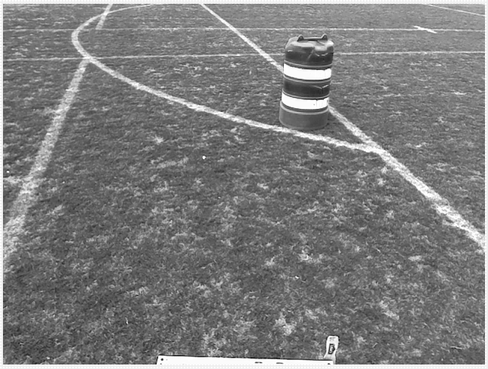
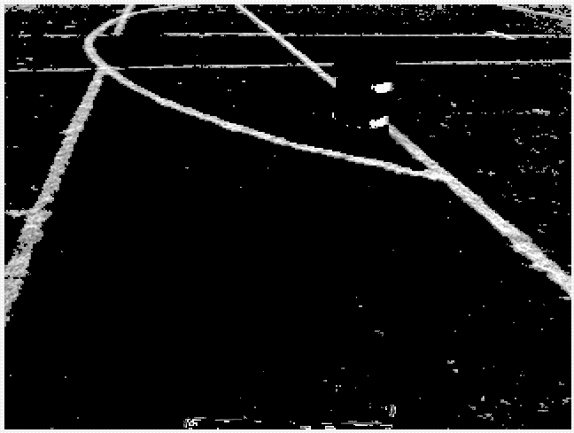
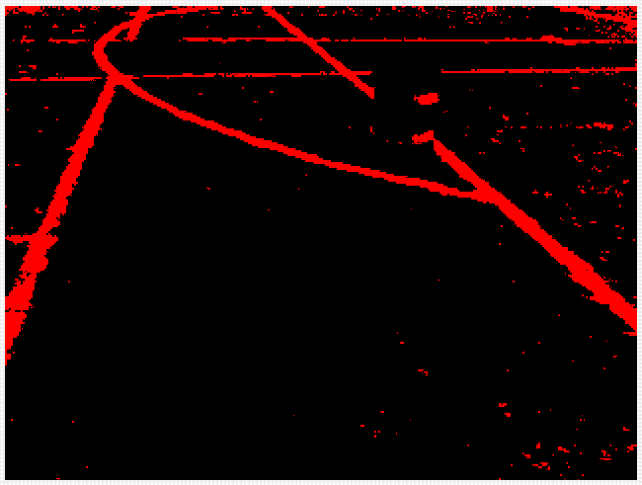
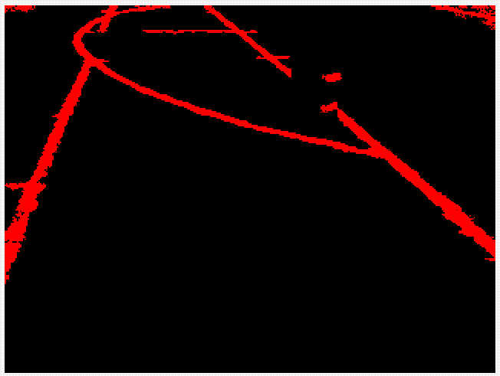
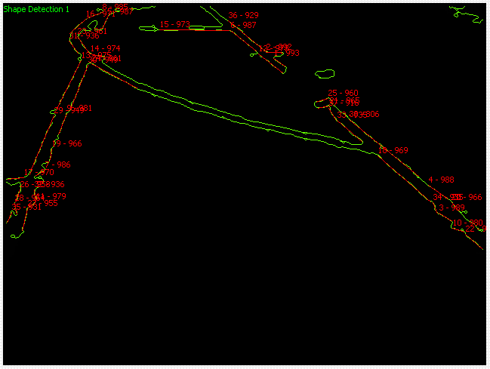
Vision acquisition
General Procedure

Slide 15



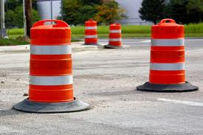
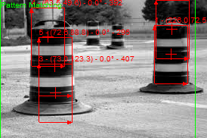
Improving Barrel Detection Algorithm
Use monochromatic bands in template

Slide 16
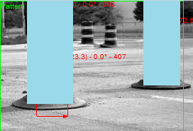
Create a “skyscraper barrel” mask
Needs implementation along with noise filtering
Reasoning
Robot cannot fly or jump over obstacles
Advantage
Less computation time
Robot should only care about immediate obstacles
Don’t care about smaller templates (too far)

Slide 17
Concluding remarks
Hardware Strengths
Sensor and Software Strengths
Original design
Fast and maneuverable design
Capacity to meet all objectives
Lightweight and durable
Reliable safety mechanisms
Agile in off-road terrain
Large field of view for obstacle detection
Unique software design
Easy to remove and service battery rack
Reliable GPS data
Hybrid and parallel control algorithm scheme

Slide 18




acknowledgements
Partner Sponsor
Other Sponsors

